Slide 1



Notes:
Hello everyone, we are team7. Our team name is STEAMCODE, which stands for Community Detection on Steam Game Posters.

Slide 2
Outline
01
02
03
04
05
Why?
What is data?
Dimension Reduction
CD Algorithms
Insights and Demo
Notes:
There are actually three parts: Why we do the project, How we go through the workflow, What insights and interesting stories we get.

Slide 3
01
Why?
Notes:
Let me answer the question by ask you guys some questions first.

Slide 4
Are you a game player?
Notes:
Do you know Steam?
Do you have a steam account?
How many games do you have?

Slide 5
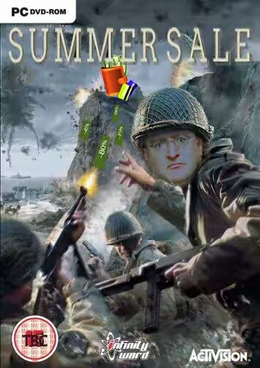






Why? SAVE MONEY
Notes:
If the answers for all the previous are ‘yes’, sth would happen like that.

Slide 6
Why? SAVE MONEY
✅
❌
Notes:
So, here comes our first objective: Help we player to save money.
Nodes with box shape indicate the games are on summer sale, while the normal sphere nodes are not.

Slide 7
Do you want to become a senior game player ?
Notes:
As Prof.Leong said, to become an expert in a field, you must know about the history first.
You not only play some games, you also have some knowledge about how the games develops, and know some stories of the games.
Our system can help

Slide 8
Do you know …
Notes:
Too famous that … Sometimes when I talk to people about my major … “Hi, man. What’s your major” “CS” “WHAT? You major in playing COUNTER STRIKE???”

Slide 9
Do you know …

Slide 10
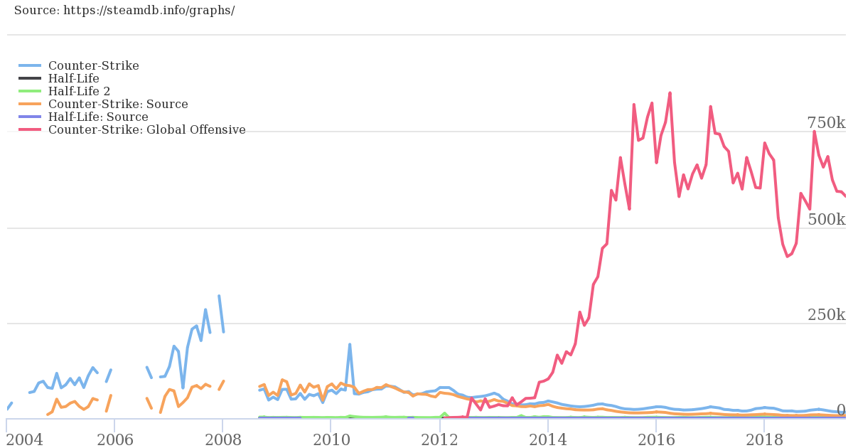
Do you know …
Notes:
All time active players.

Slide 11
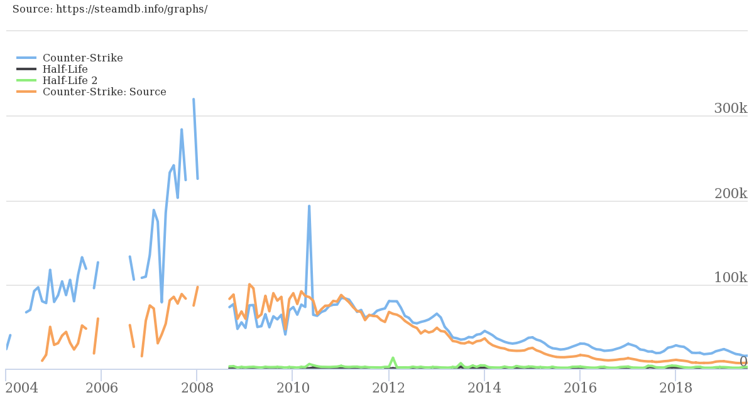
Do you know …

Slide 12
Do you know …
Counter Strike comes from Half-Life
Notes:
The original version of CS was a third-party module for Half-Life, so it was named Half-Life: Counter-Strike. However, with the popularity gained after the launch, CS became an indie game and was released in the city.

Slide 13
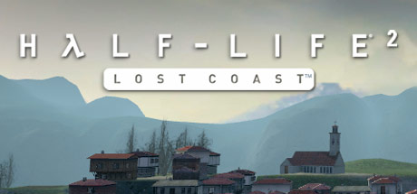

Do you know …
Counter Strike comes from Half-Life
Notes:
The original version of CS was a third-party module for Half-Life, so it was named Half-Life: Counter-Strike. However, with the popularity gained after the launch, CS became an indie game and was released in the city.
By the way, pubg is also.

Slide 14
02
What is the data?

Slide 15



Dataset & Subclasses
What is the data?
Kind of data: Header (tiny poster) image of Steam games (460x215) in .jpg format.
Source: The images are from Steam

Slide 16

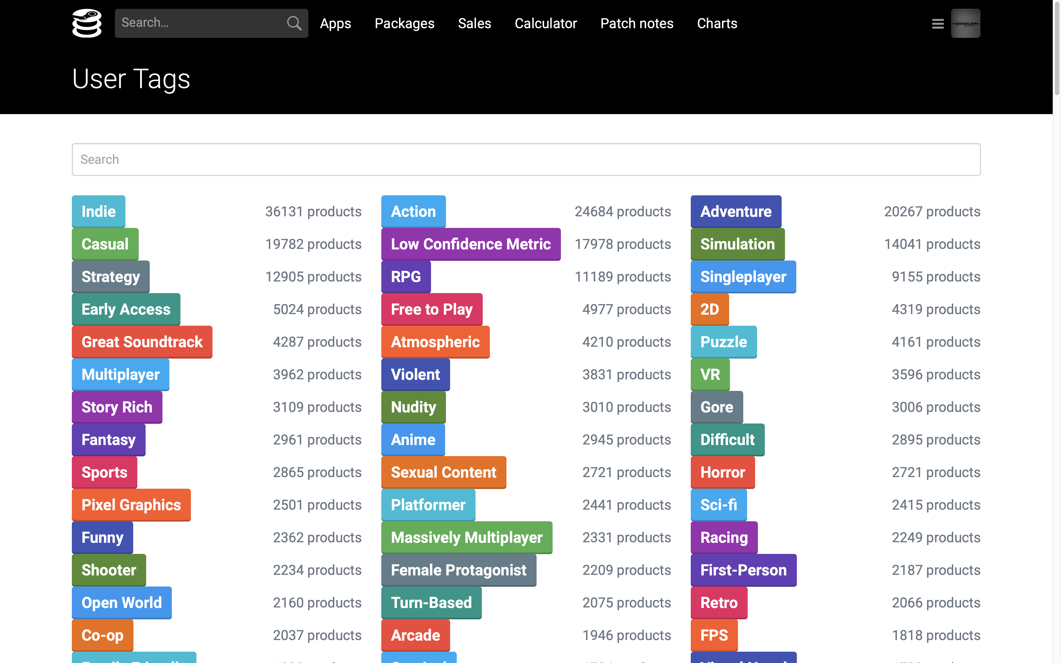
Game tags (Data to confirm our expected results)
At manually selection stage, we choose about 21 tags out of all those tags. ( According to number of games and uniqueness of style )
We manually select about 10 images in each tag according to the quality of header images.
Notes:
And choose some game series.

Slide 17
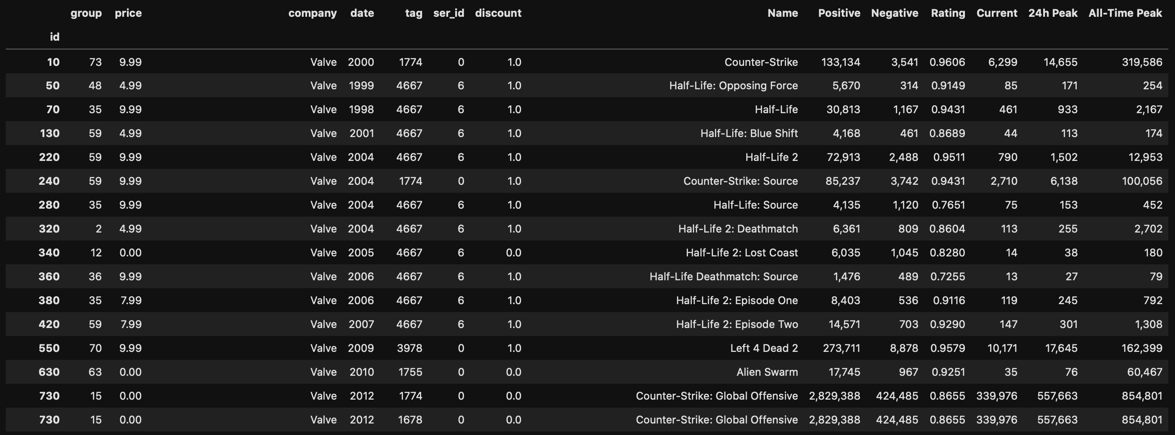
Dataset & Subclasses
What is the data?

Slide 18
Dimension Reduction
03

Slide 19
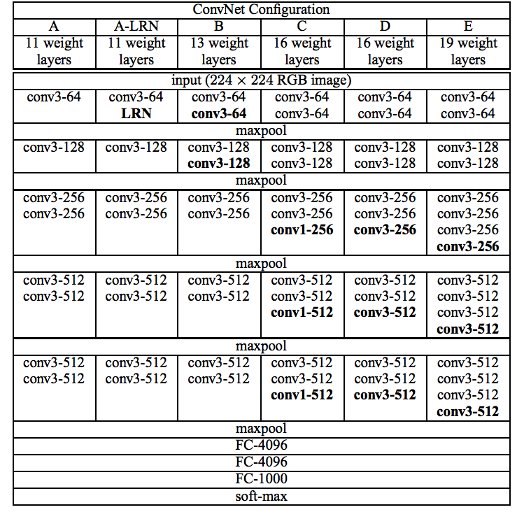
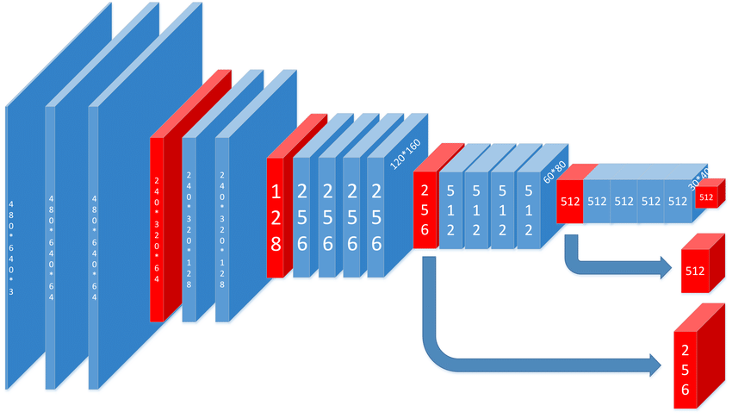
Dimension Reduction
Preprocessing
Two ways:
1.Vgg19
Notes:
p1: At the first beginning, we used two methods to pre-process the game posters to get their feature vectors to compute the distance matrix. So, we can apply CD algorithms.
the first one is Vgg19, it's a convolutional neural network that is trained on more than a million images from the ImageNet database .The number 19 stands for the number of layers with trainable weights. 16 Convolutional layers and 3 Fully Connected layers.
these are some basic structures and intuition of vgg-19.
(指着图) This is a chart from the original paper, you can see, the column E refers to VGG-19 architecture, these are the sixteen convolutional layers, and these are the three fully connected layers.

Slide 20
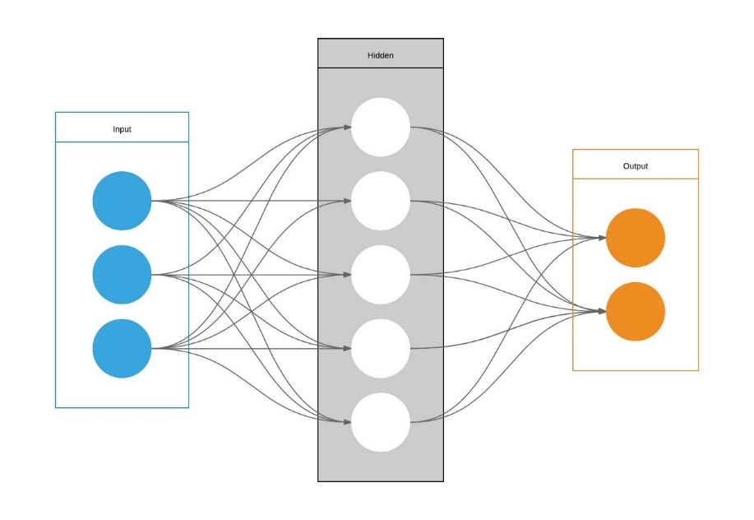
Dimension Reduction
Preprocessing
Two ways:
2. Simple AutoEncoder
Notes:
p2: the next one is simple AutoEncoder. it's a neural network made up of three layers; the input layer, one hidden layer and an output layer. One of its features is that it doesn't have so strong constraints as PCA.Then my teammates will talk about our initial attempts

Slide 21
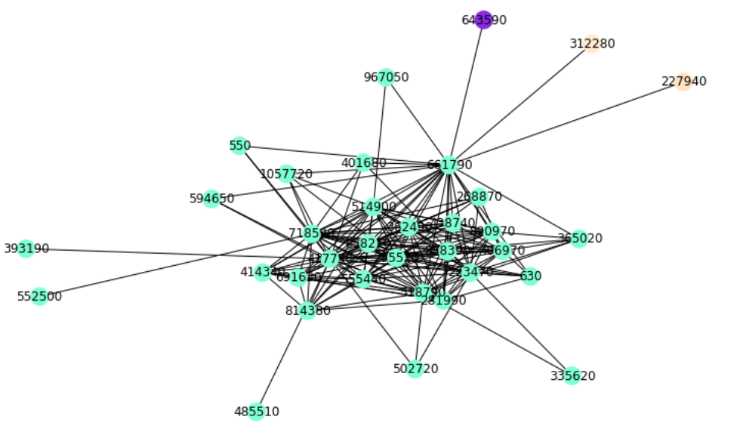
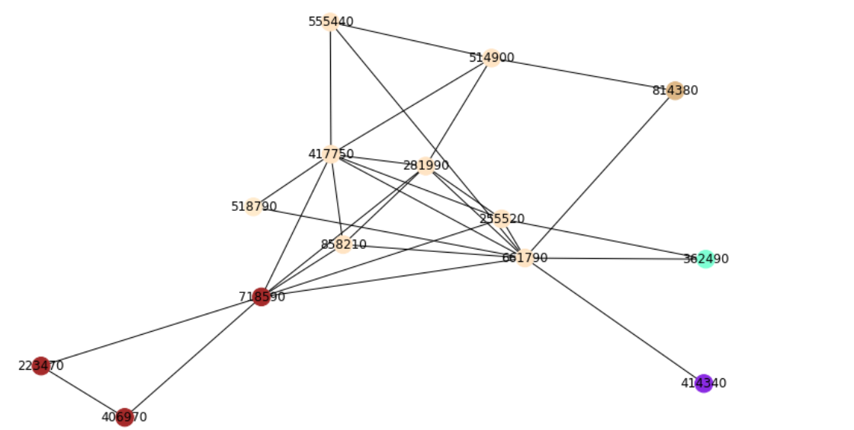
Dimension Reduction
At the beginning
Notes:
at the begining, we used gn, cfm, FastUnfolding, lpa and other cd algorithms to Community detection . but The results are similar.
When the threshold is big, almost all the points are gathered together.
in order to get enough community, we reduce the threshold until there is a good result.
but At this time, we find that the data loss is too serious.We have a dilemma

Slide 22

Dimension Reduction
Details
t-SNE with PCA for dimension reduction
Notes:
p3: so, we decided to try dimension reduction, After the preprocessing, we use t-SNE with PCA to implement the dimension reduction, We have reduced the dimension to get some new data of different dimensions, and the results of two dimension are as follows.

Slide 23
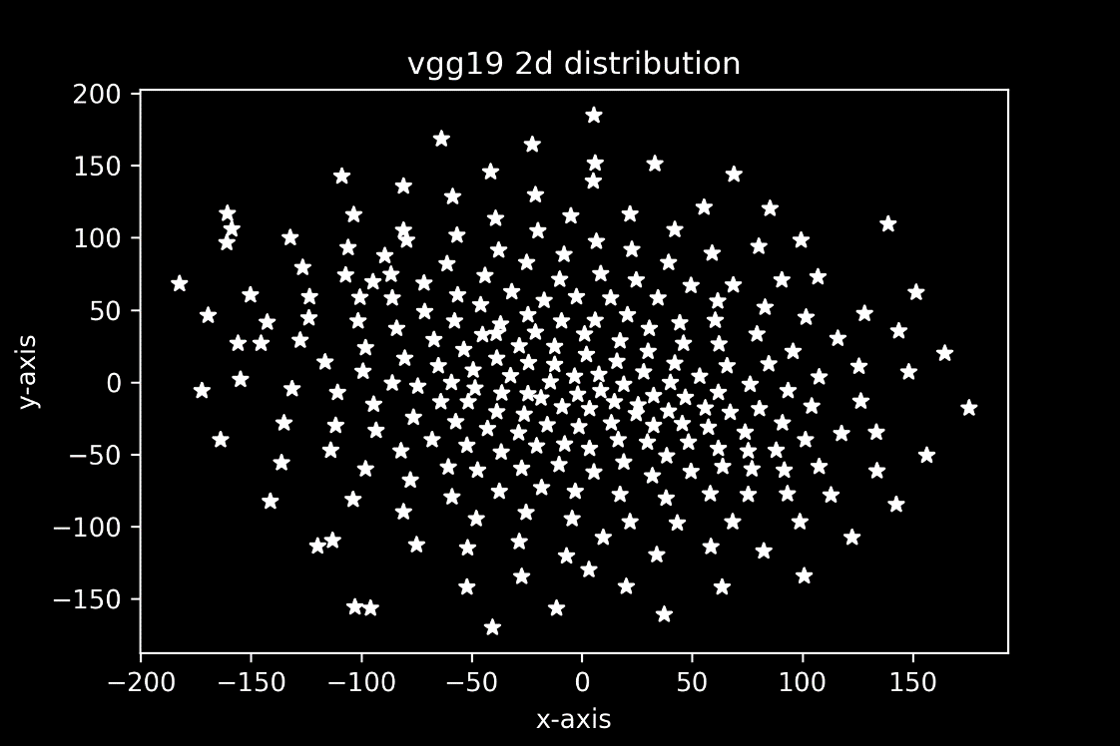
Dimension Reduction
Some two-dimensional results
For Vgg19：
Notes:
p4: That is the two-dimensional result when we use vgg for preprocessing.

Slide 24
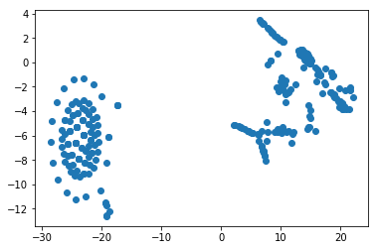
Dimension Reduction
Some two-dimensional results
For Simple AutoEncoder：
Notes:
p5:This is the two-dimensional result when we use simple AE for preprocessing.

Slide 25
04
CD algorithms

Slide 26
CD algorithms
Which algorithm should we use?
Notes:
After the dimension reduction, we use the new data to cd algorithm.

Slide 27
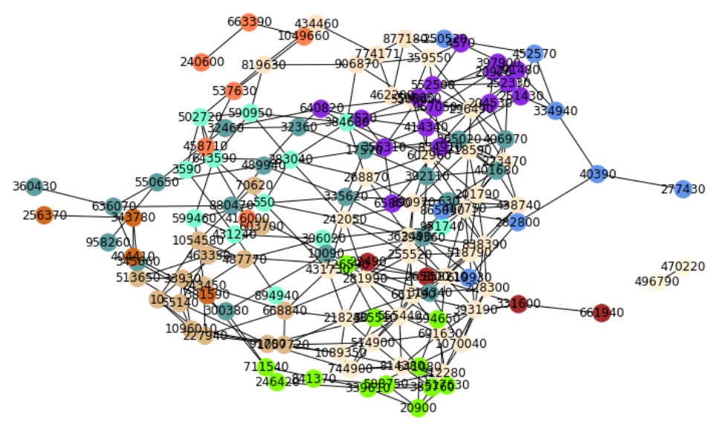
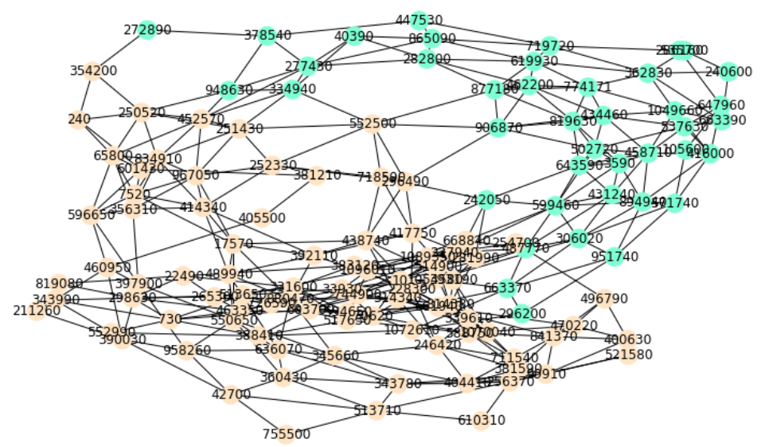
CD algorithms
Girvan–Newman
Notes:
at first we try gn algorithm.when the data is small, the result is great,
but when we use all my datas,
we find that the nodes mainly belonged to several large Community . so no

Slide 28
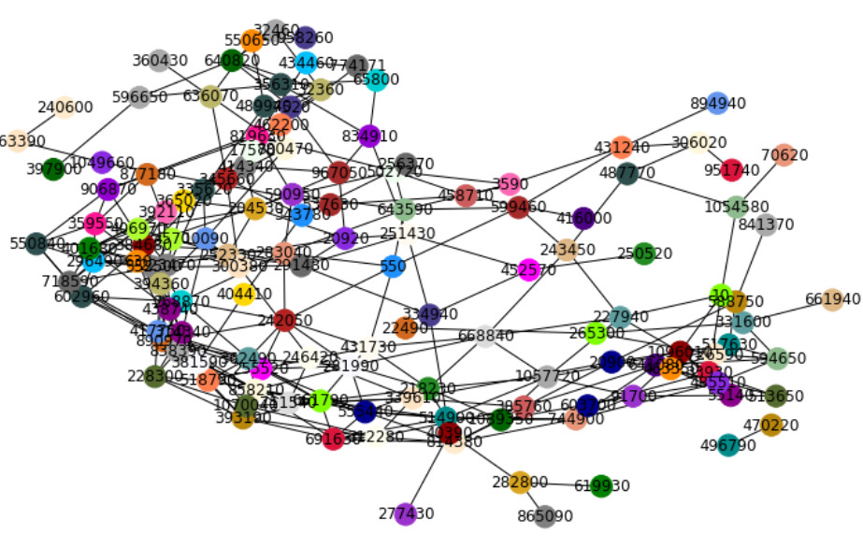
CD algorithms
Greedy_modularity
Notes:
Last time, a group mentioned that the greed_modularity algorithm was better when the amount of data was large,
so we try the greed_modularity algorithm to community detection.
We have found that there are enough Community now, but most of them are invalid Community because they only contain 2or 3 nodes. so no

Slide 29
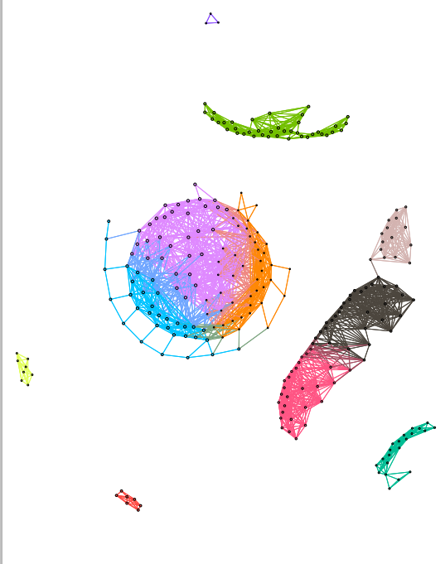
CD algorithms
FastUnfolding
Notes:
After comparing by eye and using modularity, we finally choose the FastUnfolding algorithm as our cd algorithm.

Slide 30
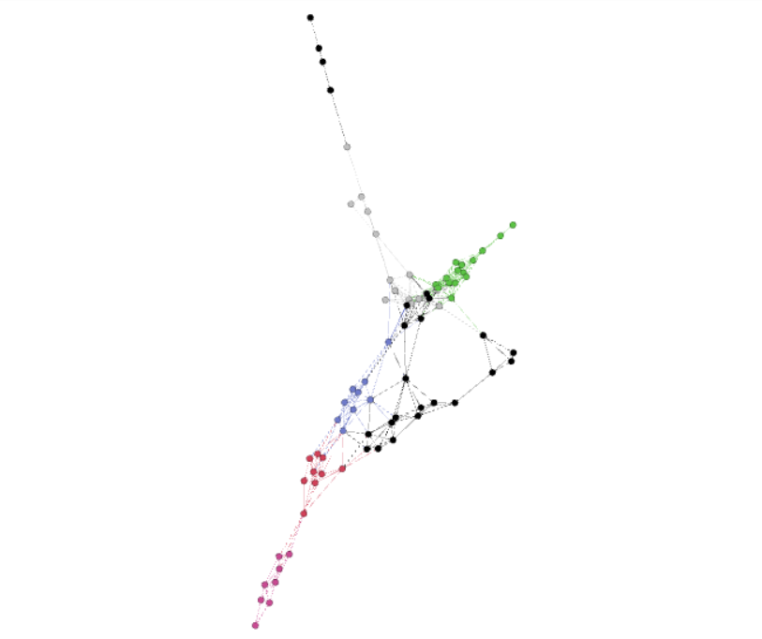
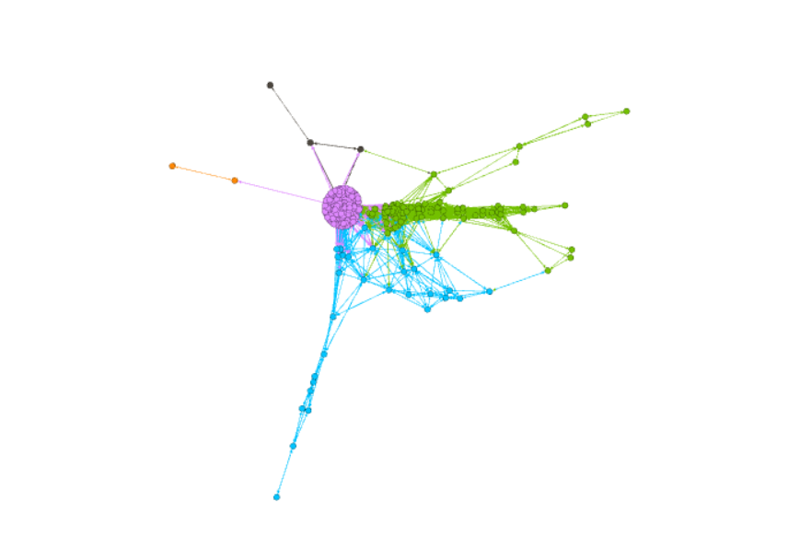
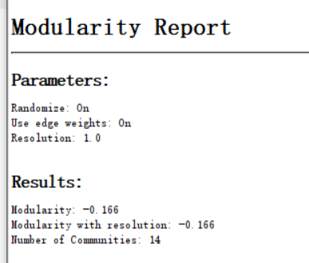
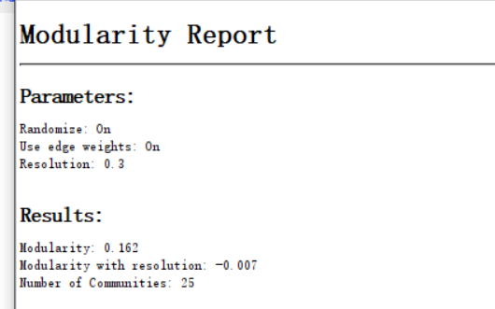
CD algorithms
Then, Do the filtering to get better graph.
After filtering the edges
After filtering the nodes
After filtering the edges
After filtering the nodes
Notes:
p6:Based on the weight of the edge and the degree of the node, aiming to apply the algorithm perfectly, we do the edge and node filtering
you can see, when we do the filtering of the edge weight, we can get the change of the graph like this(筛边图), It’s clear that games are roughly divided into 14 communities, and nodes of each community share some commonalities. when we go further, remove those nodes with a very large degree, we can find that the previous big communities will be scattered, and produce more smaller communities. Correspondingly, the number of communities will increase to 25 as well.

Slide 31
CD algorithms
How many dimensions should we reduce?

Slide 32
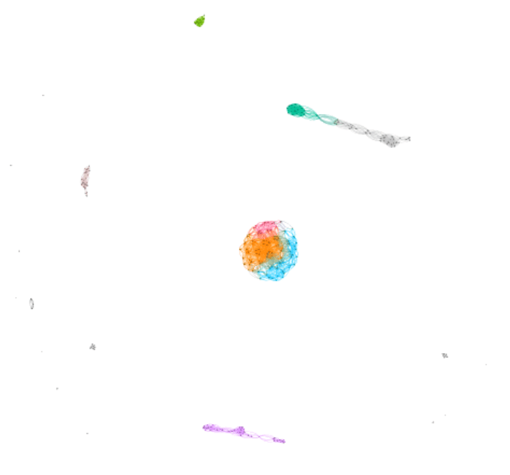
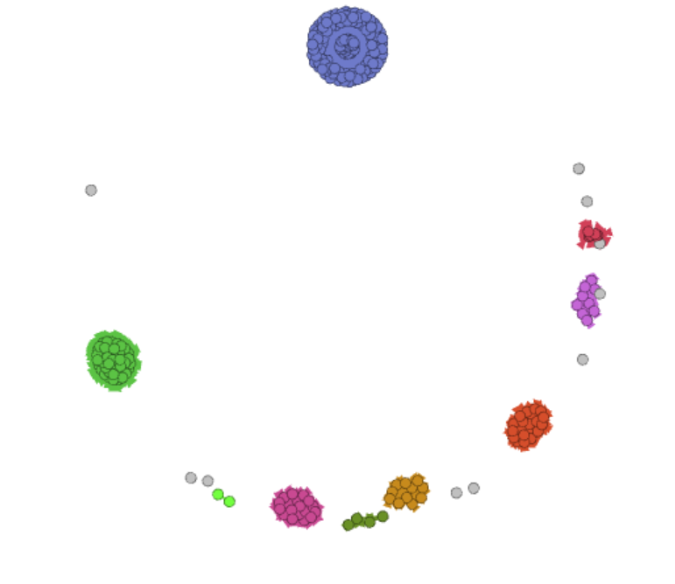
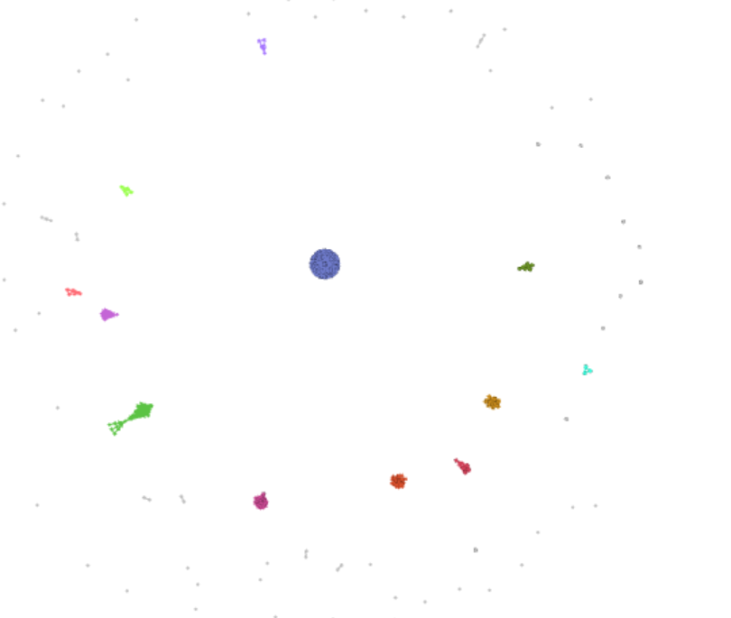
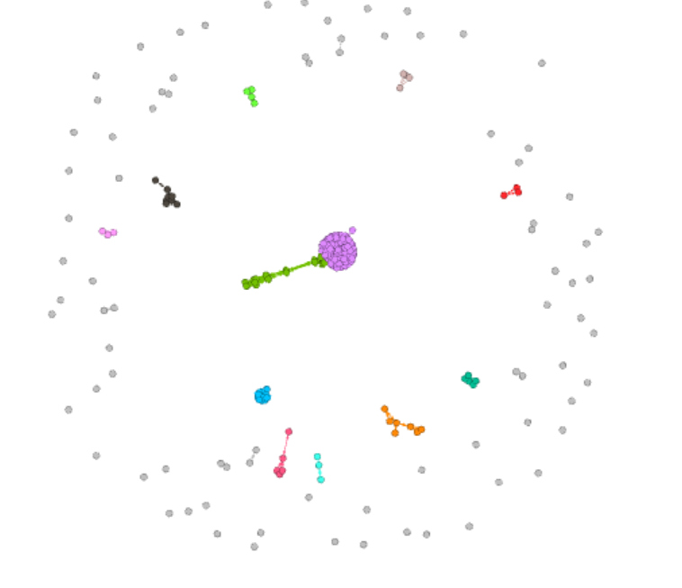
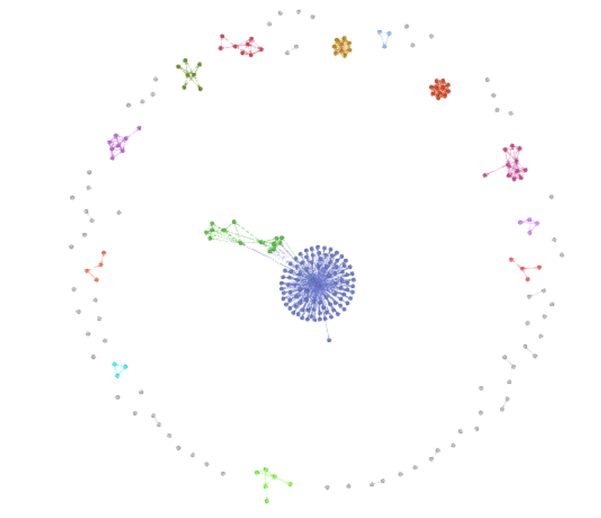
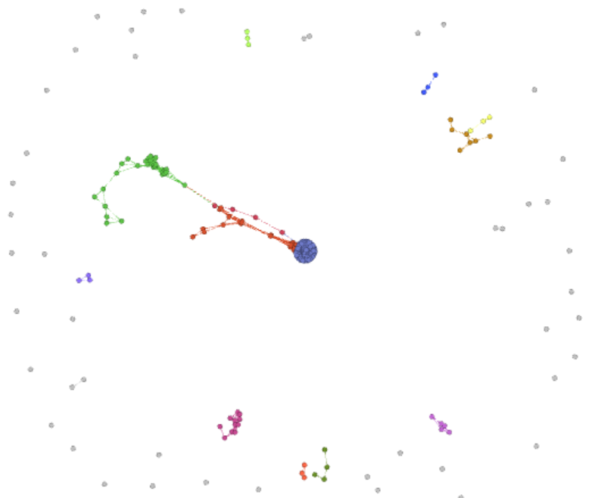
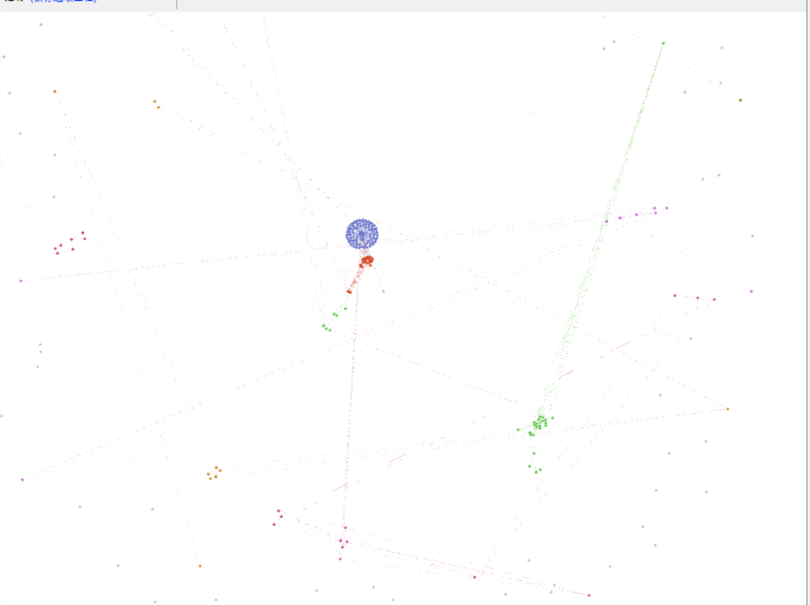
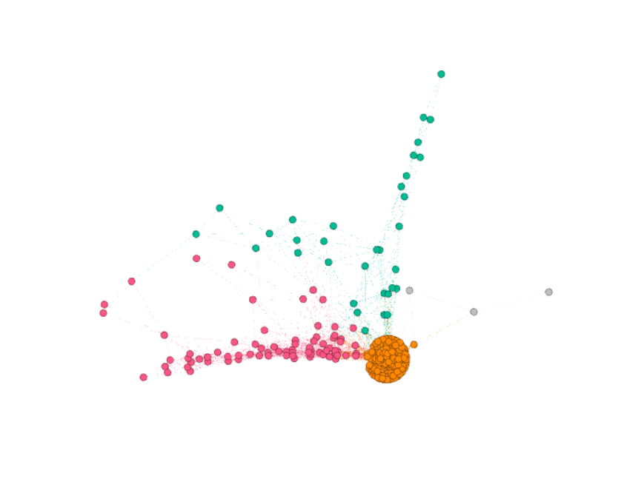
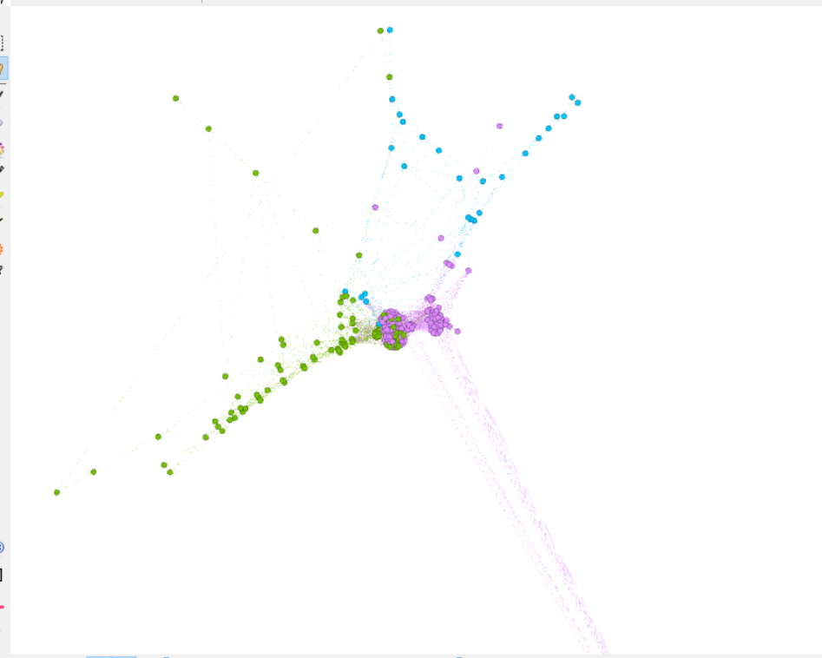
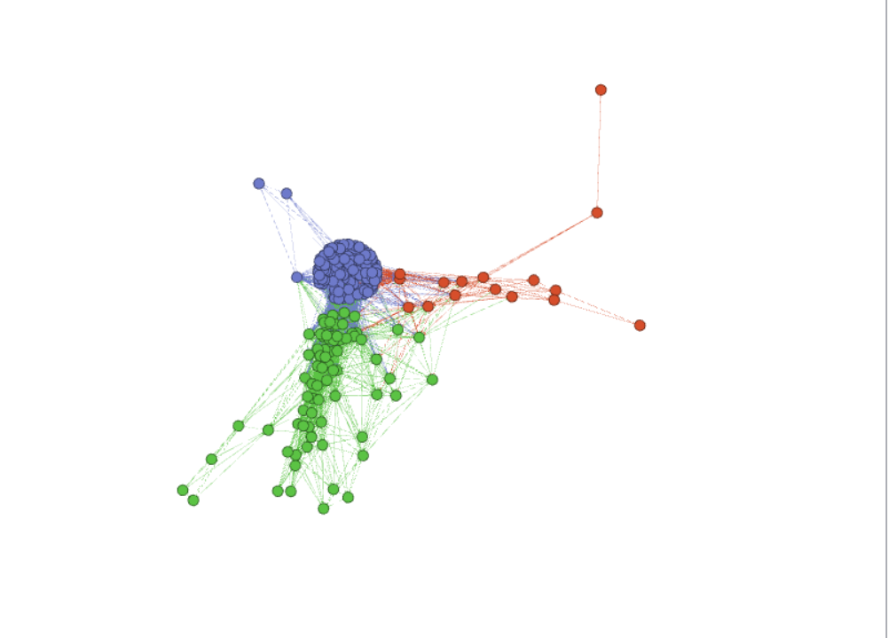
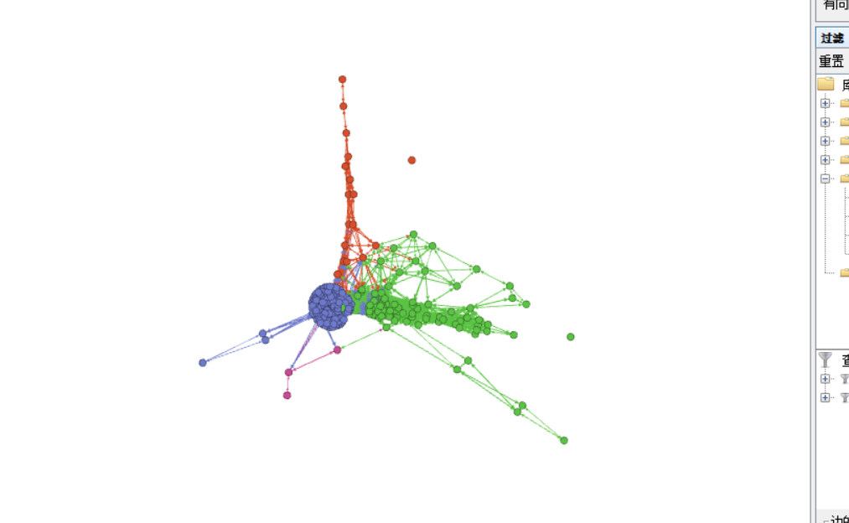
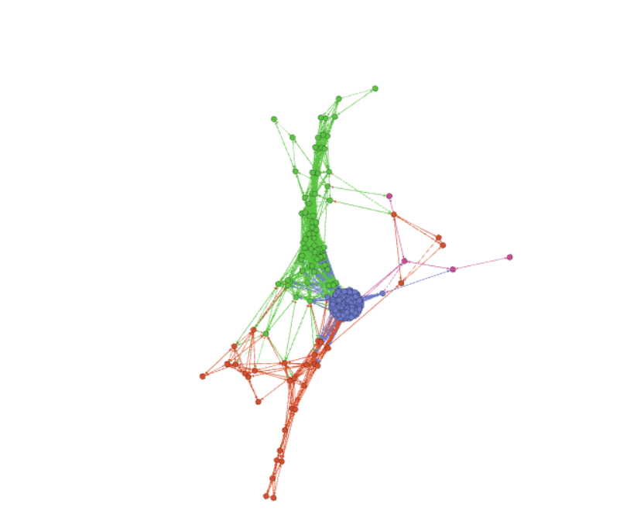
CD algorithms
simple_AE
2d
3d
5d
30d
num:11 modularity:0.232
num:9 modularity:-0.306
num:12 modularity:-0.326
num:12 modularity:-0.302
40d
50d
…
…
num:12 modularity:0.036
num:13 modularity:-0.318
num:67 modularity:0.232
num:13 modularity:-0.317
…
90d
100d
200d
num:13 modularity:-0.187
num:13 modularity:0.089
num:10 modularity:-0.236
num:12 modularity:-0.215
Notes:
we use the sample_ae to get the data from 2d to100d.then use fastupfolding to community detection.we using modularity to express the quality of the results.

Slide 33
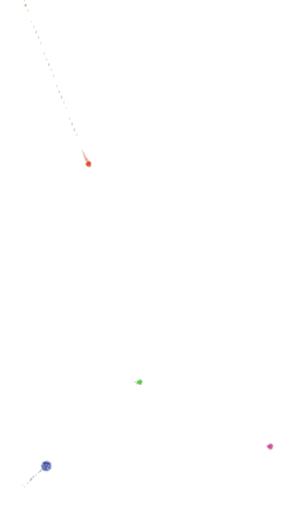
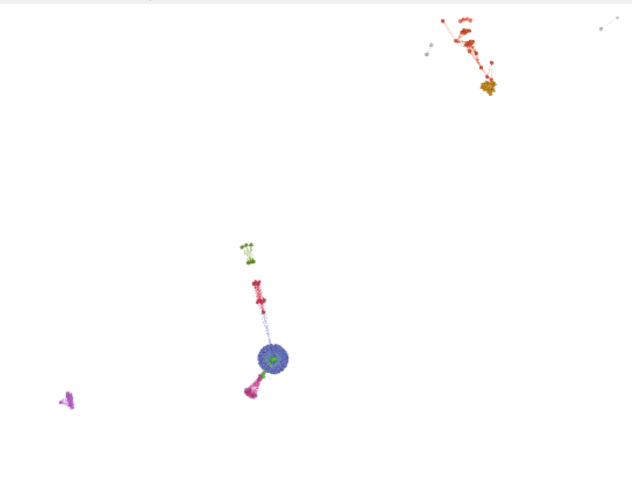
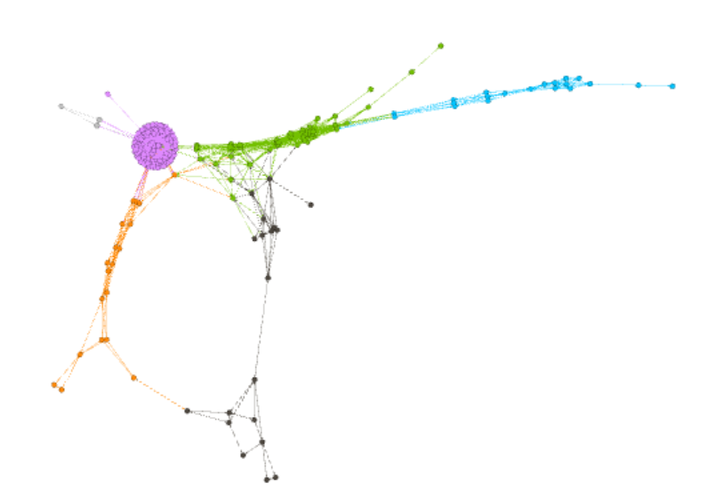
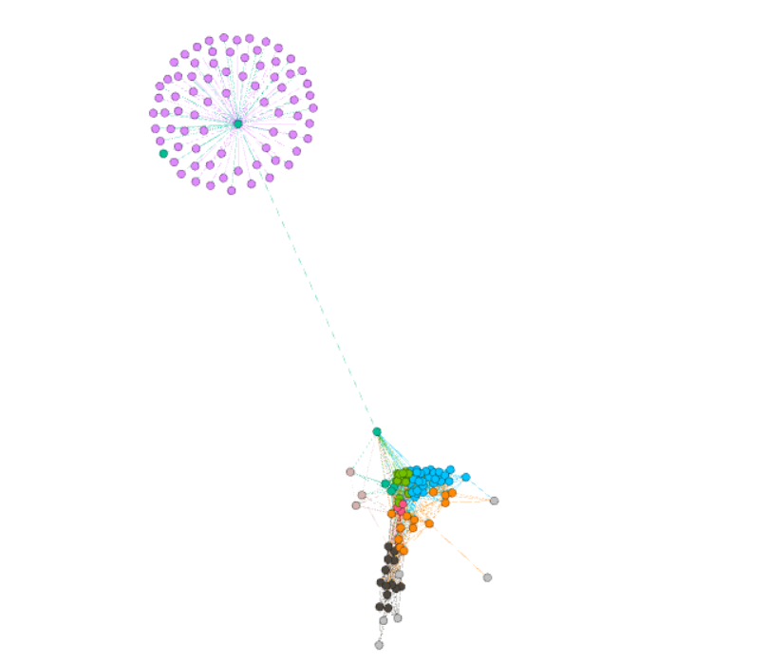
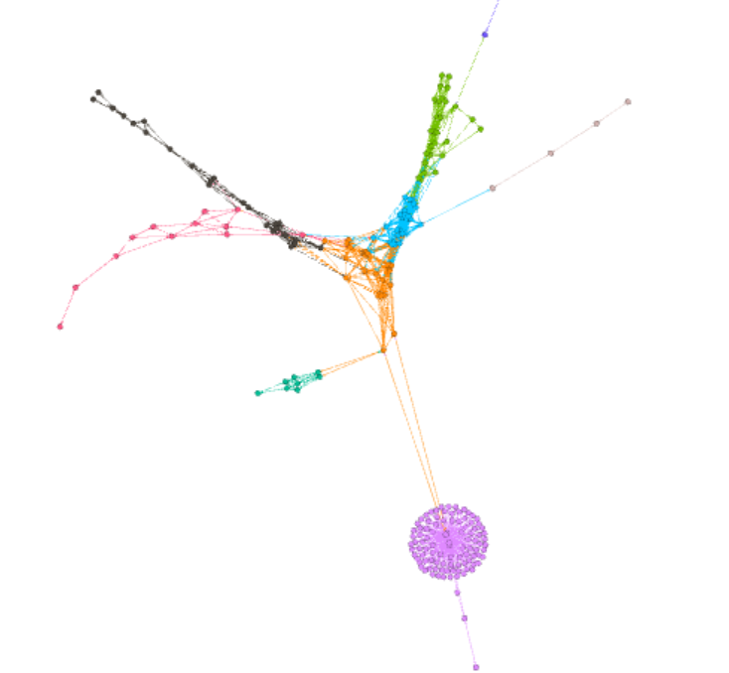
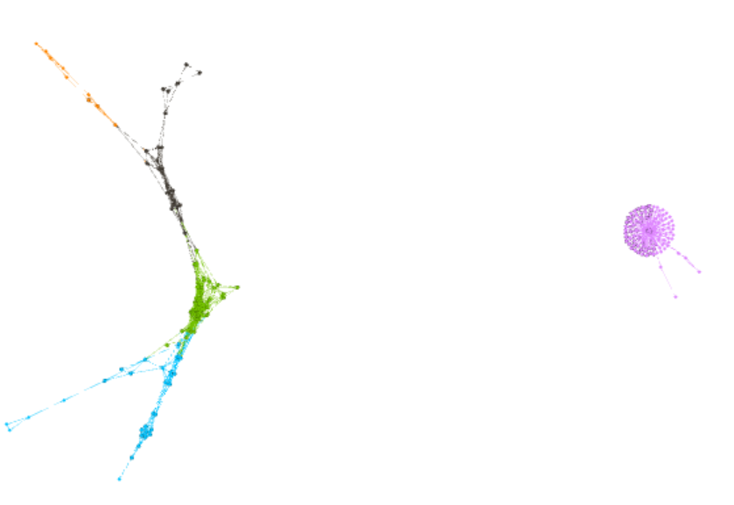
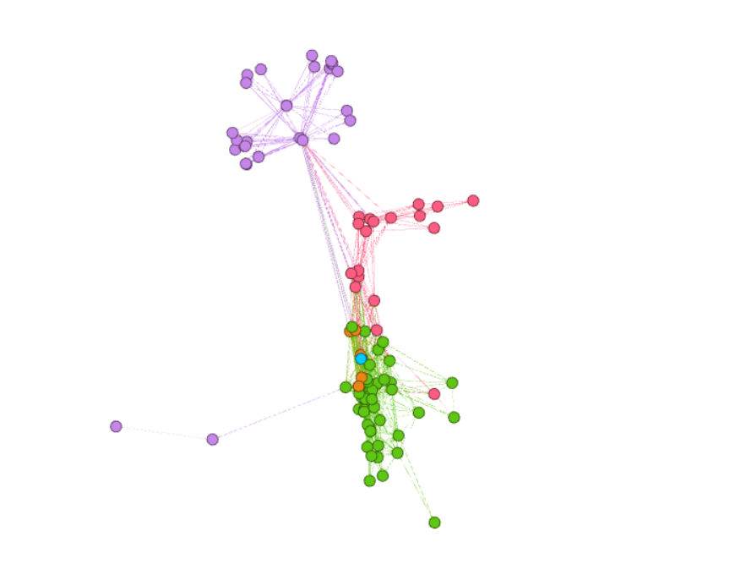
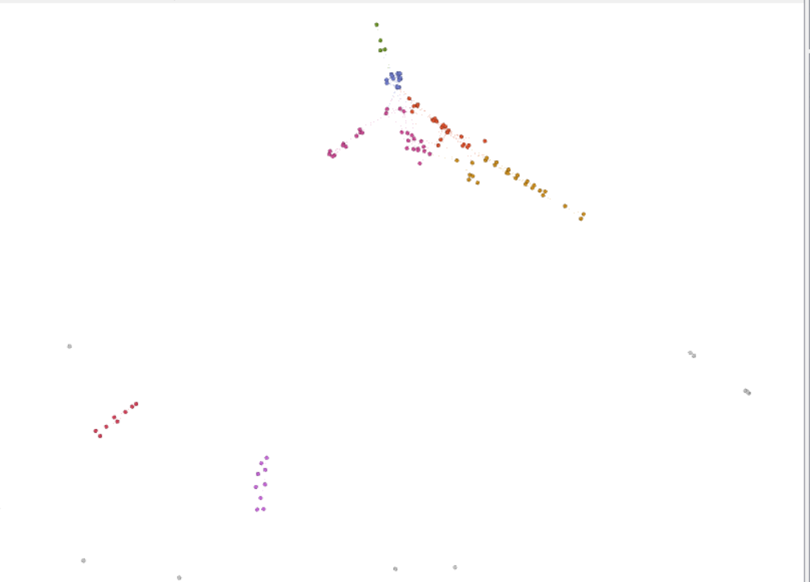
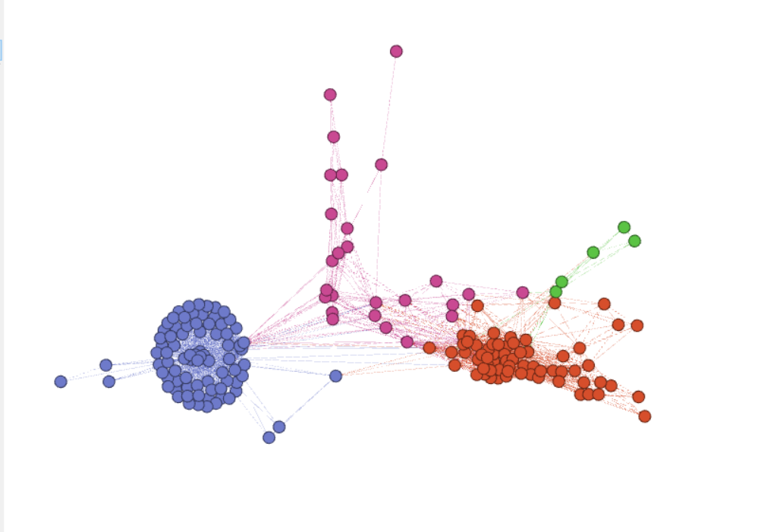
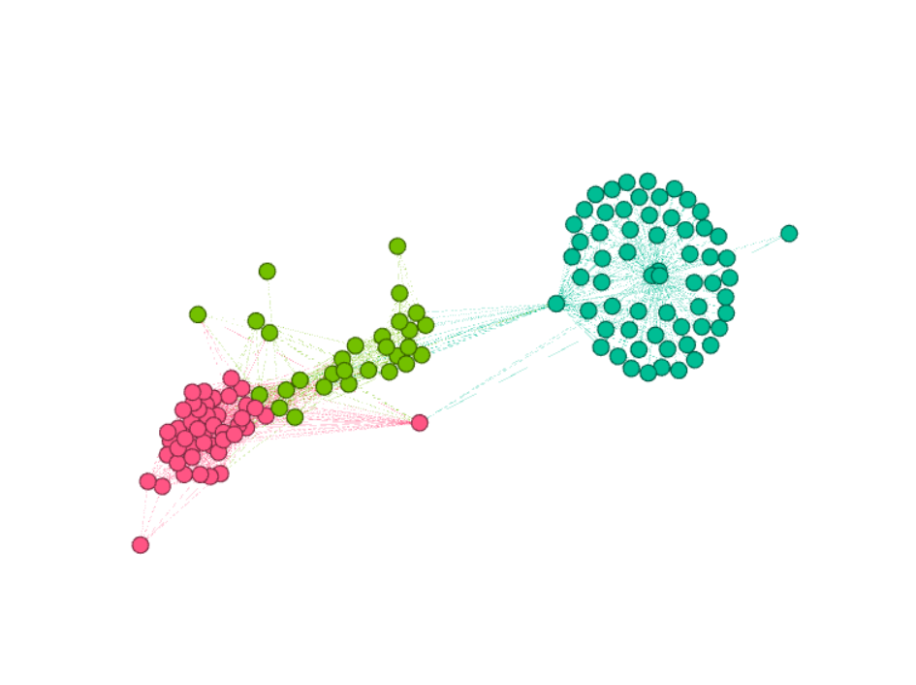
CD algorithms
simple_AE
num:11 modularity0.294
num:8 modularity-0.293
num:12 modularity0.029
num:11 modularity0.029
num:10 modularity0.185
num:9 modularity0.115
num:7 modularity-0.015
num:6 modularity-0.124y
num:27 modularity0.021
num:9 modularity-0.044
num:5 modularity-0.041
Notes:
In order to get more sub_community, we remove some central points, reuse the community detertion and calculate its modularity.

Slide 34
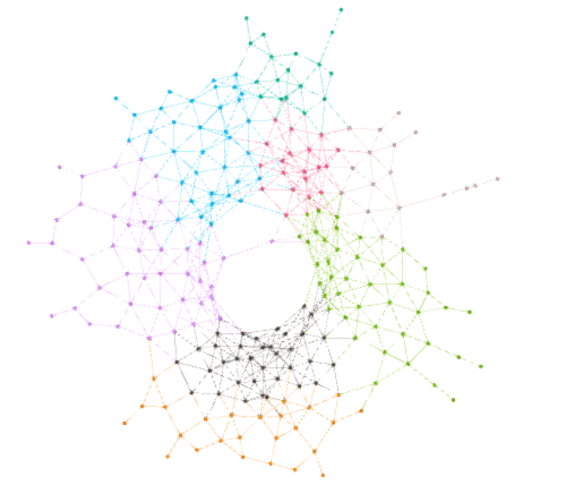
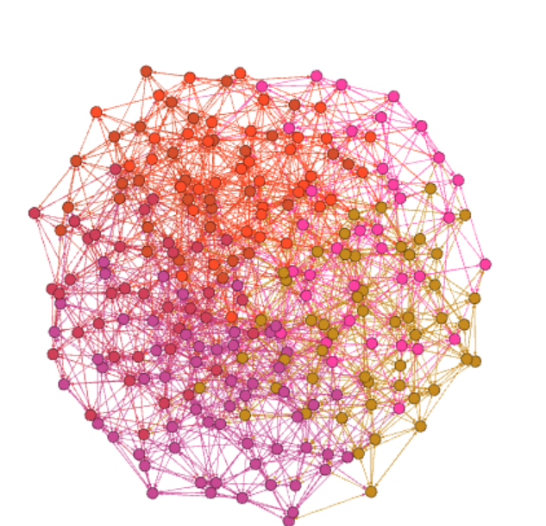
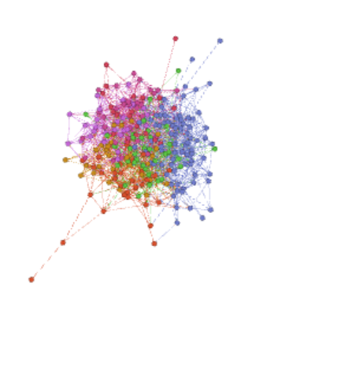
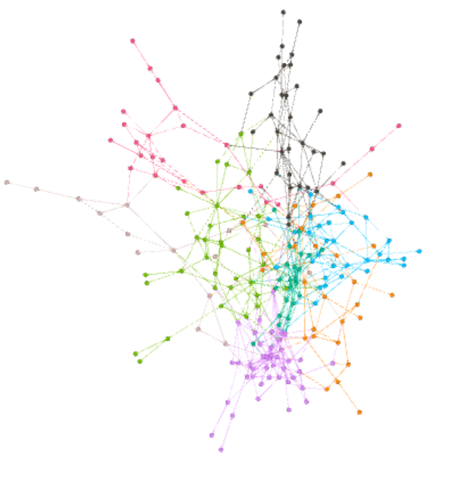
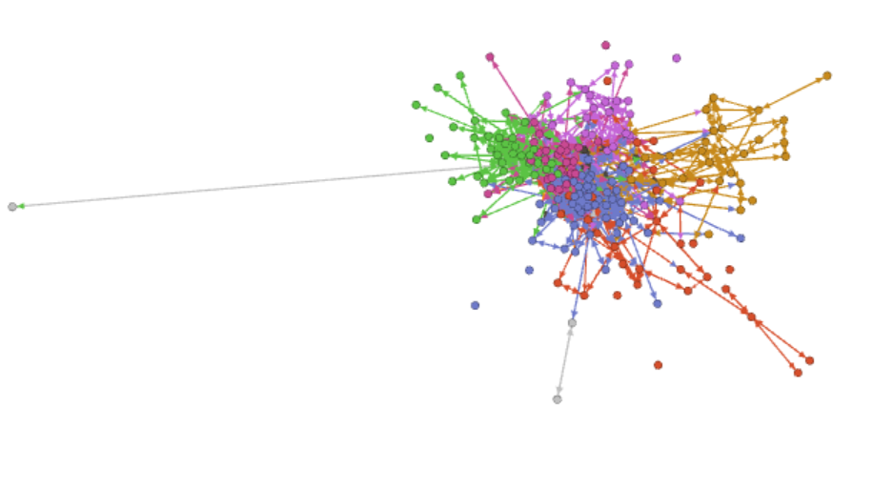
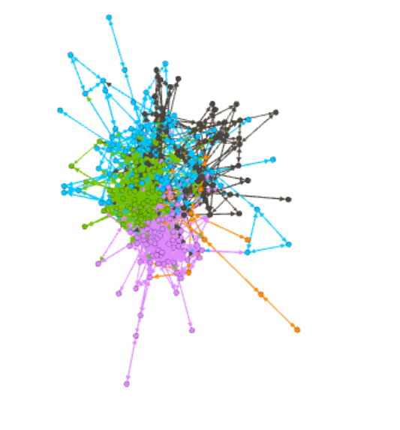
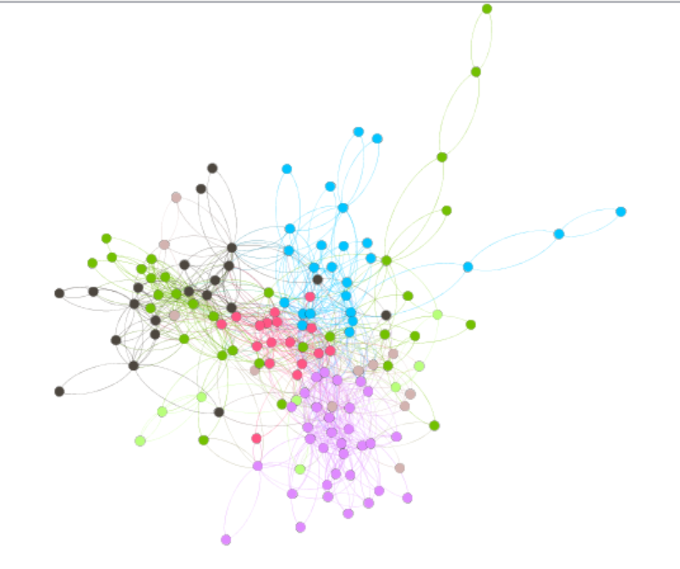


CD algorithms
vgg
num:10 modularity0.228
num:6 modularity0.141
num:8 modularity0.104
num: 7 modularity0.251
num: 6 modularity0.185
num: 8 modularity0.038
num:11 modularity0.173
num:5 modularity-0.016
num:6 modularity-0.066
Notes:
We also reduce the dimension through the vgg algorithm.
finally,we chose ..to analyse
.we can see something intersting .the result is better when the picture's dimension is reduced to 2d.
We found that after we used Vgg algorithm to reduced dimension, many communities are still connected together,
when we used sample_ae algorithm to reduced dimension, the communities are separated well .its intersing.but we cannt explain it well
after we use picture to compare them.we can see,vgg mainly seperate the picture by shape and sample_ae mainly separete them by color

Slide 35
05
Insights & Demo

Slide 36

Results
11 communities
SimpleAE
After t-SNE
Dimension: 2

Slide 37

Results
10 communities
vgg19
After t-SNE
Dimension: 2

Slide 38





What we know we know
Series games belong to closer community generally.

Slide 39

What we know we know
Most of action games have image in same community.
(e.g. war games and shooter games)

Slide 40

What we don’t know we know
Horror games and action games can belong to same community. ( with high frequency )
Many horror games have action elements.
Many action games have dark and bloody scenes
Both above affect the design style of the posters.

Slide 41






What we don’t know
Images in the same community appear similar in tone. (simpleAE)
Images in the same community appear similar in shape. (vgg19)
simpleAE community #3
simpleAE community #5

Slide 42






What we don’t know
Vgg19 community #1
Vgg19 community #9

Slide 43




Something Interesting
Let’s focus on game series!

Slide 44

Something Interesting
Community #10
Community #5

Slide 45
Something Interesting
What happened to Half-life ?
Source
New game engine
Handles the game's visual, audio, and artificial intelligence elements.
The Source engine comes packaged with a heavily modified version of the Havok physics engine that allows further interactivity. When coupled with Steam, it becomes easy to roll out new features.
Community #10
Community #5

Slide 46

Something Interesting
Mike Harrington
Harrington founded Valve in 1996 with Gabe Newell, another former Microsoft employee. He and Newell privately funded Valve for the development of Half-Life.
On January 15, 2000, after the success of Half-Life, Harrington dissolved his partnership with Newell and left Valve to take an extended vacation. Actually, he and his wife started the journey around the world with a 77-foot boat.
Harrington returned to the software industry in 2006.
He is currently the CTO at The Committee for Children.

Slide 47



Something Interesting
Ooooooops! CS and Half-life in the same community!
2000
2004
1998
Notes:
1998

Slide 48


Something Interesting
Ooooooops! CS and Half-life in the same community!
2004
2005

Slide 49




Something Interesting

Slide 50


Something Interesting
Ubisoft has unified design style!
(A yu zhen zhuan yi! )

Slide 51





Something Interesting

Slide 52
Reference
[1] http://steamdb.info
[2] https://github.com/ankonzoid/artificio
[3] https://scikit-learn.org/stable/modules/clustering.html#affinity-propagation
[4] https://en.wikipedia.org/wiki/Half-Life_2
[5] https://en.wikipedia.org/wiki/Half-Life_2:_Episode_One
[6] https://en.wikipedia.org/wiki/Counter-Strike
[7] https://en.wikipedia.org/wiki/Counter-Strike_(video_game)
[8] https://en.wikipedia.org/wiki/Tomb_Raider

Slide 53
THANKS
Notes:
Do you know Steam?
Do you have a steam account?
How many games do you have?

Slide 54
Q&A
Notes:
Do you know Steam?
Do you have a steam account?
How many games do you have?

